Slide 1
Facial Emotion Based on
Deep Learning
By: Deepak Kolli

Slide 2
Goal
Our goal is to be able to take an image of a face and tell what kind of expression/emotion the person is showing
Are they smiling? Are they shocked? Are they sad? That is what our models are meant to detect
Page #

Slide 3
The Approach
We’re gonna be building numerous models to see which one performs the best
First models: CNN Models
Three Transfer Learning Models: VGG16, ResNet, EfficientNet
Final Model: Complex CNN Model

Slide 4
Model Architecture
Each of the three transfer learning models consist of the first 5 layers of its respective model with 6 layers added to them: a flatten layer, 4 dense layers, a dropout layer, and a batch normalization layer. The CNN models were constructed differently.
Transfer Learning Model
Flatten
Dense (256)
Dense (128)
Batch Normalization
Dense (64)
Dropout
Dense (4)

Slide 5
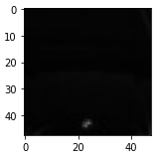
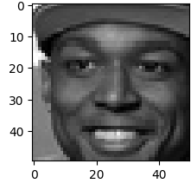
Some Things To Keep In Mind
Dataset:
The dataset only contained images in greyscale, not RGB (colored)
Some of the images weren’t faces, they were just black pictures
Training:
Each model was trained with:
A batch size of 32
A learning rate of 0.001
20 epochs
Example:

Slide 6
Model Performance
Name of Model | Accuracy | Loss
CNN Model 1 | 63% | 0.83
CNN Model 2 | 72% | 0.72
VGG16 | 72% | 0.72
ResNet | 25% | 1.4
EfficientNet | 25% | 1.4
Complex Model | 65% | 0.73

Slide 7
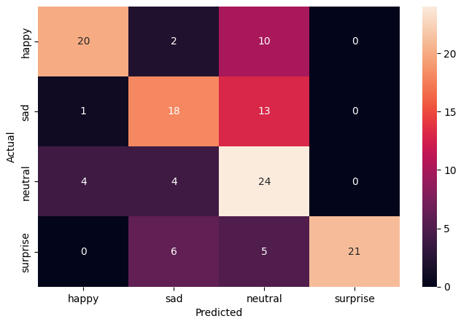
Confusion Matrix

Slide 8
Key Takeaways
The VGG16 and the CNN Model 2 performed the best, while the ResNet and the EfficientNet models performed the worst based on accuracy and loss
For most of the models, increasing epochs meant that the metrics would improve, which reduces the chance of overfitting. The worst two performing models did not have a linear growth pattern.
Seen for the first two models, the number of layers the model has, the improvement of metrics are shown. It may be beneficial to add more layers to see if our models can improve even more.
It may be worth it to try and build upon ResNet and EfficientNet to try and see if we can get those to work properly since those are transfer learning models, they won’t take up too much resources when compiling.

